Slide 1
CS312 Artificial Intelligence
Lecture # 06
HITEC University, Taxila
Mr. Mubashir Iqbal
Fall-2025

Slide 2
Lecture Content
Advanced ML Algorithms – I:
Supervised Learning
Decision Trees
Random Forests
Support Vector Machines (SVM)
Advanced Machine Learning Algorithms – II:
Unsupervised Learning
K-Means Clustering

Slide 3
Scikit-learn (sklearn) – Python Machine Learning Library

Slide 4
Scikit-learn (sklearn)
Scikit-learn (sklearn) is a widely used open-source Python library that provides simple and efficient tools for machine learning, data preprocessing, model evaluation, and data splitting.
It is built on top of:
NumPy (numerical computation)
SciPy (scientific computing)
Matplotlib (visualization)
Why Scikit-learn is Important in AI
Industry-standard ML library
Easy-to-use and consistent API
Supports supervised, unsupervised, and semi-supervised learning
Strong documentation and community
Used in research, industry, and education

Slide 5
Scikit-learn (sklearn)
Core Design Philosophy
Consistent API (fit(), predict(), transform())
Modular components
Focus on classical ML (not deep learning)

Slide 6
Main Functional Areas of Scikit-learn
1. Supervised Learning Models: Used when labeled data is available.
Classification Algorithms
Logistic Regression
Support Vector Machine (SVM)
Decision Tree
Random Forest
K-Nearest Neighbors (KNN)
Naïve Bayes
from sklearn.linear_model import LogisticRegression
from sklearn.svm import SVC
from sklearn.neighbors import KNeighborsClassifier
from sklearn.tree import DecisionTreeClassifier
from sklearn.ensemble import RandomForestClassifier
from sklearn.naive_bayes import GaussianNB

Slide 7
Main Functional Areas of Scikit-learn
1. Supervised Learning Models: Used when labeled data is available.
Regression Algorithms
Linear Regression
Ridge & Lasso Regression
Decision Tree Regressor
Random Forest Regressor
Support Vector Regression (SVR)
from sklearn.linear_model import LinearRegression, Ridge, Lasso
from sklearn.svm import SVR
from sklearn.tree import DecisionTreeRegressor
from sklearn.ensemble import RandomForestRegressor

Slide 8
Main Functional Areas of Scikit-learn
2. Unsupervised Learning Models: Used when no labels are available.
K-Means Clustering
Hierarchical Clustering
DBSCAN
Principal Component Analysis (PCA)
from sklearn.cluster import KMeans, AgglomerativeClustering, DBSCAN
from sklearn.decomposition import PCA

Slide 9
Main Functional Areas of Scikit-learn
3. Data Splitting & Model Validation: Used to train and test models properly.
train_test_split
Cross-validation
K-Fold, Stratified K-Fold
from sklearn.model_selection import (
train_test_split,
KFold,
StratifiedKFold,
cross_val_score
)

Slide 10
Main Functional Areas of Scikit-learn
4. Data Preprocessing & Feature Engineering: Used to clean and prepare data.
Scaling (StandardScaler, MinMaxScaler)
Encoding categorical data
Handling missing values
Feature selection
from sklearn.preprocessing import (
StandardScaler,
MinMaxScaler,
LabelEncoder,
OneHotEncoder
)
from sklearn.impute import SimpleImputer

Slide 11
Main Functional Areas of Scikit-learn
5. Model Evaluation & Metrics: Used to measure model performance.
Accuracy
Precision, Recall, F1-Score
Confusion Matrix
ROC-AUC
from sklearn.metrics import (
accuracy_score,
precision_score,
recall_score,
f1_score,
confusion_matrix,
classification_report,
mean_squared_error,
r2_score
)

Slide 12
Scikit-learn
Common Machine Learning Workflow using Scikit-learn
Load dataset
Split data
Preprocess features
Train model (fit)
Predict (predict)
Evaluate performance
Advantages
Easy to learn
Consistent syntax
Efficient for small & medium datasets
Excellent for teaching ML fundamentals
Limitations
Not suitable for deep learning
Limited support for very large datasets
No GPU acceleration

Slide 13
Supervised Learning

Slide 14
Supervised Learning
Supervised Learning is when a model learns from labeled data, meaning the correct answers are already provided. The model simply learns the pattern between input and output.
Example: You give images of cats and dogs with labels, and the model learns to identify them.
The goal is to learn a mapping from inputs to outputs so that the model can predict the label for new, unseen data
Used for: Classification (categorizing data) and regression (predicting continuous values).

Slide 15
Decision Trees

Slide 16
Decision Trees
A Decision Tree is a supervised machine learning algorithm that predicts an output by learning decision rules from data and organizing them in a tree-like structure. Each internal node represents a test on a feature, each branch represents an outcome of the test, and each leaf node represents a final prediction.
Why Decision Trees are Important
Mimic human decision-making
Easily interpretable (rules can be read directly)
Widely used in AI-based decision systems

Slide 17
Decision Trees
Basic Structure of a Decision Tree
Root Node → First feature used to split data
Internal Nodes → Feature-based decision points
Branches → Outcomes of decisions
Leaf Nodes → Final class or value
How a Decision Tree Works (Step-by-Step)
Start with the full training dataset
Select the best feature to split the data
Split the dataset into subsets
Repeat the process for each subset
Stop when:
All records belong to the same class
No features are left
A stopping condition is met (depth, samples)

Slide 18
Example (Iris Dataset)
sepal.length | sepal.width | petal.length | petal.width | variety
5.1 | 3.5 | 1.4 | 0.2 | Setosa
4.9 | 3 | 1.4 | 0.2 | Setosa
4.7 | 3.2 | 1.3 | 0.2 | Setosa
4.6 | 3.1 | 1.5 | 0.2 | Setosa
7 | 3.2 | 4.7 | 1.4 | Versicolor
6.4 | 3.2 | 4.5 | 1.5 | Versicolor
6.9 | 3.1 | 4.9 | 1.5 | Versicolor
6.5 | 3 | 5.8 | 2.2 | Virginica
7.6 | 3 | 6.6 | 2.1 | Virginica
4.9 | 2.5 | 4.5 | 1.7 | Virginica

Slide 19
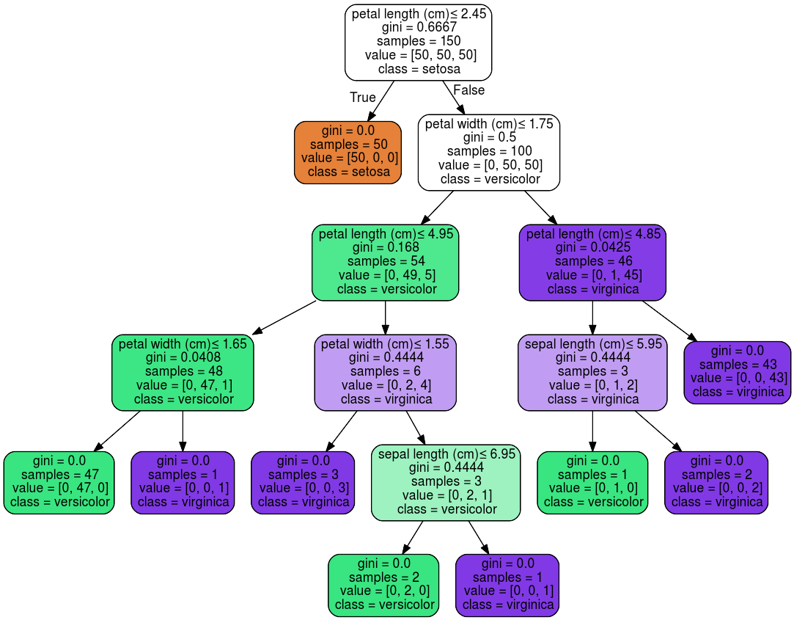

Slide 20
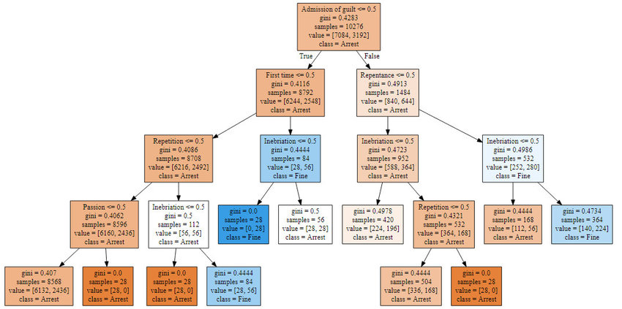
Research Title: Russian Court Decisions Data Analysis Using Distributed Computing and Machine Learning to Improve Lawmaking and Law Enforcement
A decision tree for predicting the size of the penalties under article... | Download Scientific Diagram

Slide 21
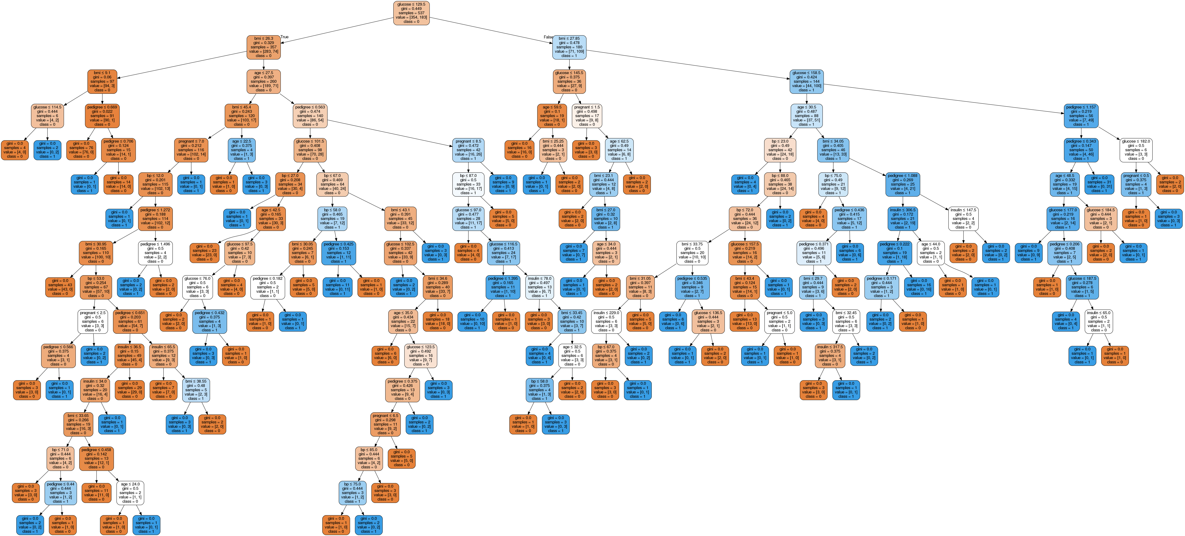
output_57_0_livyu1.png (5473×2481)

Slide 22
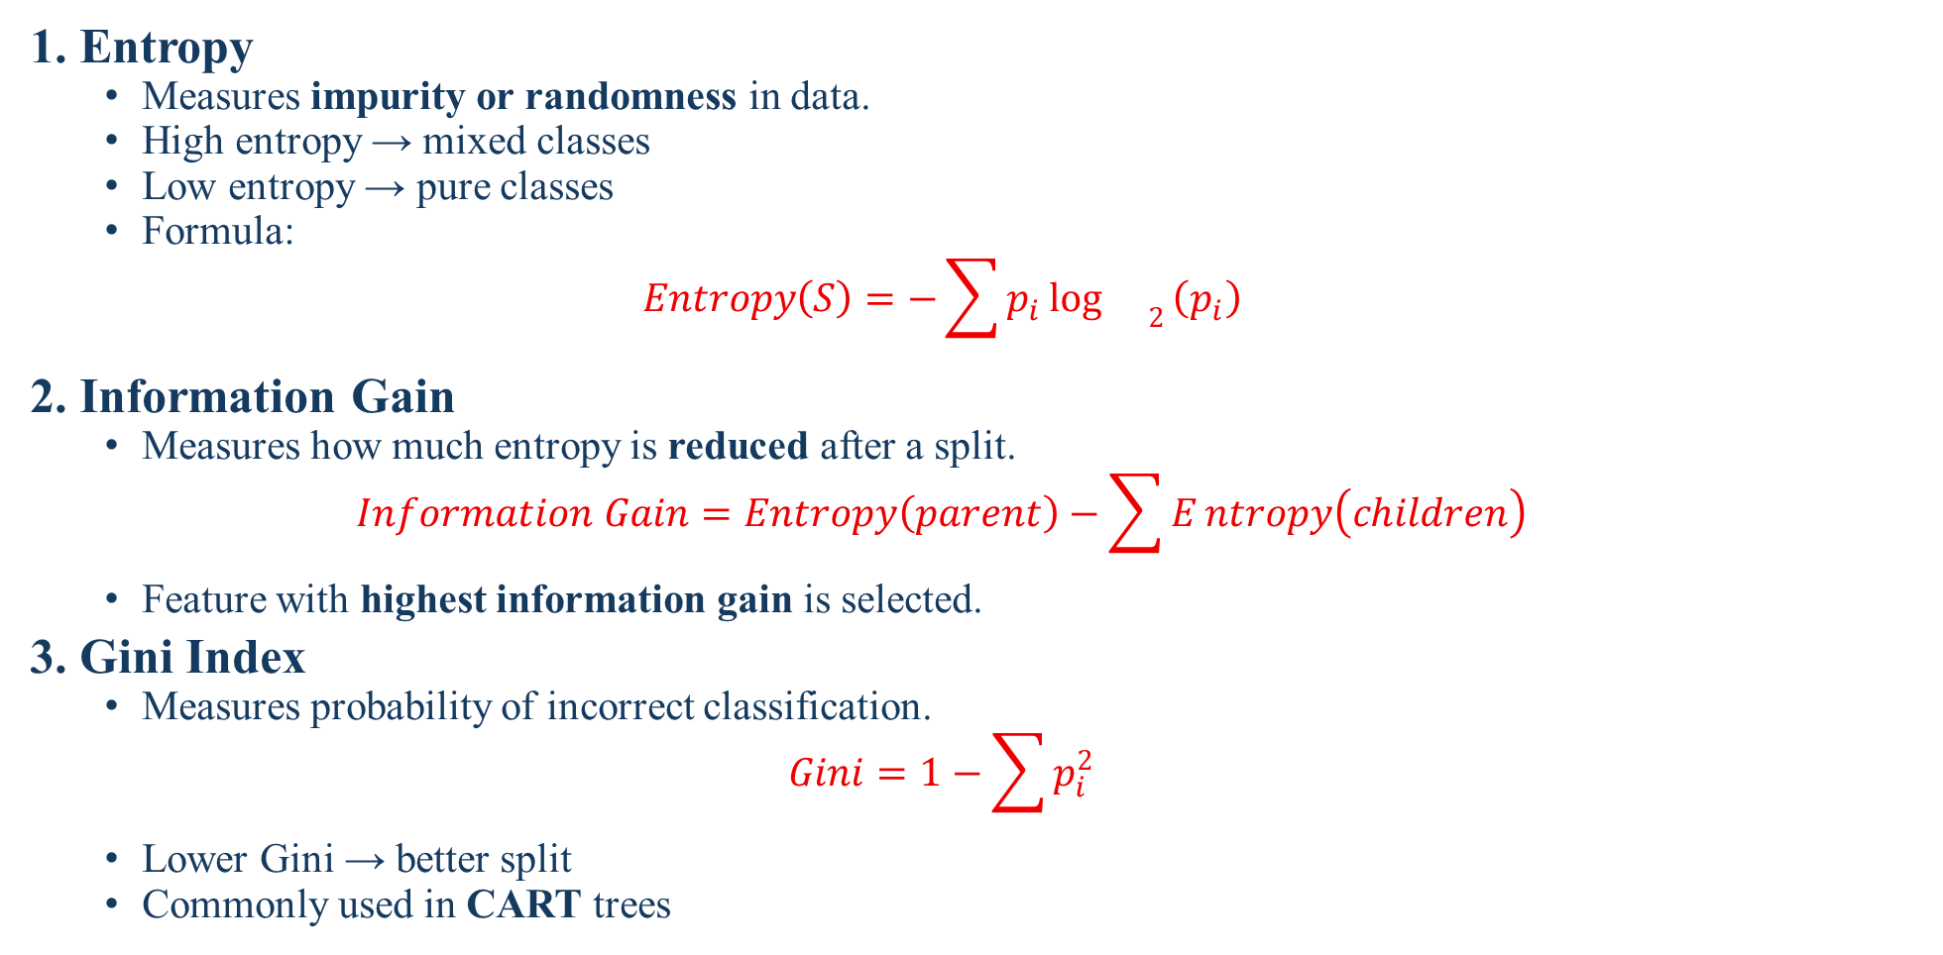
Decision Trees (Feature Selection Criteria)
1. Entropy
Measures impurity or randomness in data.
High entropy → mixed classes
Low entropy → pure classes
Formula:
$$Entropy\left(S\right)=−\sum{p_{i}}{\log{}}_{2}\left(p_{i}\right)$$
2. Information Gain
Measures how much entropy is reduced after a split.
$$Information Gain=Entropy\left(parent\right)−\sum{E}ntropy\left(children\right)$$
Feature with highest information gain is selected.
3. Gini Index
Measures probability of incorrect classification.
$$Gini=1−\sum{p_{i}^{2}}$$
Lower Gini → better split
Commonly used in CART trees

Slide 23
Decision Trees
Overfitting in Decision Trees
Decision Trees tend to overfit because they try to fit training data perfectly.
Signs of Overfitting
Very deep tree
High training accuracy, low testing accuracy
Techniques to Control Overfitting
1. Pre-Pruning
Stop tree growth early:
Limit depth
Set minimum samples per split
2. Post-Pruning
Grow full tree, then remove unnecessary branches.

Slide 24
Decision Trees
Advantages of Decision Trees
Easy to understand and visualize
Handles numerical and categorical data
No need for normalization or scaling
Works well with missing values
Disadvantages of Decision Trees
Sensitive to small data changes
Can create biased trees with imbalanced data
Less accurate than ensemble methods

Slide 25
Decision Trees (Python code for Classification)
from sklearn.tree import DecisionTreeClassifier
# Create a fully customizable Decision Tree object
dt_model = DecisionTreeClassifier(
criterion="gini", # "gini" or "entropy"
splitter="best", # "best" or "random"
max_depth=5, # Maximum depth of the tree
min_samples_split=4, # Minimum samples required to split a node
min_samples_leaf=2, # Minimum samples required at a leaf node
max_features=None, # Number of features to consider at each split
random_state=42, # For reproducibility
class_weight=None # Handle class imbalance
)

Slide 26
Decision Trees (Python code for Regression)
from sklearn.tree import DecisionTreeRegressor
dt_regressor = DecisionTreeRegressor(
criterion="squared_error",
max_depth=6,
min_samples_split=5,
min_samples_leaf=3,
random_state=42
)

Slide 27
Random Forests

Slide 28
Random Forests
Random Forest is an ensemble learning algorithm that builds multiple Decision Trees and combines their outputs to produce a more accurate and stable prediction. Instead of relying on a single tree (which may overfit), Random Forest aggregates the decisions of many trees.
For better understanding
Many weak models together can form a strong model.
Each tree:
Is trained on a random subset of data
Uses a random subset of features
Makes an independent prediction
Final result:
Classification → Majority voting
Regression → Average of predictions

Slide 29
Random Forests
Random Forest Working (Step-by-Step)
Bootstrap Sampling
Randomly select samples from the training data with replacement
Each tree gets a different dataset
Random Feature Selection
At each split, only a subset of features is considered
Reduces correlation between trees
Tree Construction
Each tree grows independently (usually unpruned)
Prediction Aggregation
Combine predictions from all trees
Improves accuracy and robustness

Slide 30
Random Forests
Key Parameters (Python programming languag)
from sklearn.ensemble import RandomForestClassifier
rf_model = RandomForestClassifier(
n_estimators=100, # Number of trees
criterion="gini", # "gini" or "entropy"
max_depth=6, # Control overfitting
min_samples_split=5, # Minimum samples to split a node
min_samples_leaf=2, # Minimum samples at leaf
max_features="sqrt", # Number of features per split
bootstrap=True, # Use bootstrap samples
random_state=42,
n_jobs=-1 # Use all CPU cores
)

Slide 31
Random Forests
Advantages
High accuracy
Reduces overfitting
Works well with large datasets
Handles missing values and noise
Suitable for both classification and regression
Limitations or Disadvantages
Computationally expensive
Less interpretable than a single tree
Large models consume more memory
Real-World Applications
Fraud detection in banking
Medical diagnosis
Credit scoring systems
Intrusion detection (Cyber Security)
Recommendation systems

Slide 32
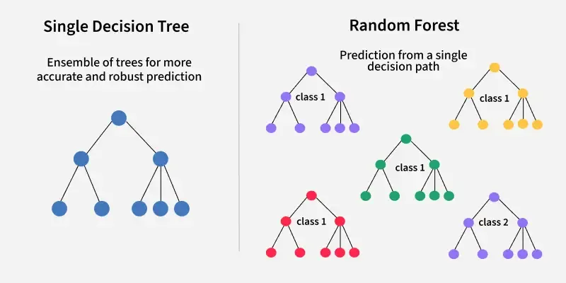

Slide 33
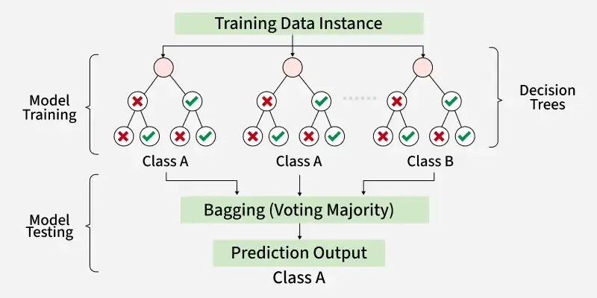

Slide 34
Support Vector Machines (SVM)

Slide 35
Support Vector Machines (SVM)
Support Vector Machine (SVM) is a supervised learning algorithm used for classification and regression that finds an optimal boundary (hyperplane) to separate data points of different classes. The key idea is to maximize the margin between different classes.
Margin in SVM
Margin = Distance between hyperplane and nearest data points
Larger margin → better generalization
SVM is known as a maximum margin classifier

Slide 36
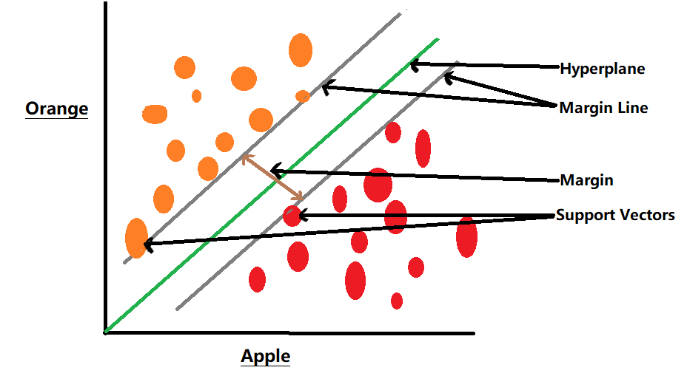
Support Vector Machines (SVM)

Slide 37
Support Vector Machines (SVM)
How SVM Works (Step-by-Step)
Plot the Data
Each data point is represented in feature space
Find Possible Decision Boundaries
Many lines (or planes) can separate classes
Select the Optimal Hyperplane
SVM chooses the boundary with maximum margin
Identify Support Vectors
Points closest to the hyperplane
They control the position of the boundary

Slide 38
Support Vector Machines (SVM)
Types of SVM
Linear SVM
Used when data is linearly separable
Straight line (2D), plane (3D), hyperplane (higher dimensions)
Non-Linear SVM
Used when data is not linearly separable
Uses Kernel Trick to map data to higher dimensions
Why SVM is Important in AI
Strong mathematical model
Excellent performance on small-to-medium datasets
Commonly used in security-related classification problems

Slide 39
Support Vector Machines (SVM)
Advantages of SVM
Works well in high-dimensional spaces
Effective when number of features > samples
Robust against overfitting
Strong theoretical foundation
Limitations
Computationally expensive on large datasets
Sensitive to kernel and parameter selection
Less interpretable than Decision Trees
Real-World Applications
Face recognition
Text and spam classification
Bioinformatics
Intrusion detection systems
Handwritten digit recognition

Slide 40
Support Vector Machines (SVM)
svm_model = SVC(
C=1.0, # Regularization parameter
kernel="rbf", # Kernel type: linear, poly, rbf, sigmoid
degree=3, # Degree for polynomial kernel
gamma="scale", # Kernel coefficient: scale, auto, or float
coef0=0.0, # Used in poly and sigmoid kernels
shrinking=True, # Use shrinking heuristic
probability=False, # Enable probability estimates
tol=0.001, # Tolerance for stopping criterion
cache_size=200, # Cache size in MB
class_weight=None, # Handle class imbalance
verbose=False, # Print training logs
max_iter=-1, # No limit on iterations
decision_function_shape="ovr", # one-vs-rest
random_state=42
)

Slide 41
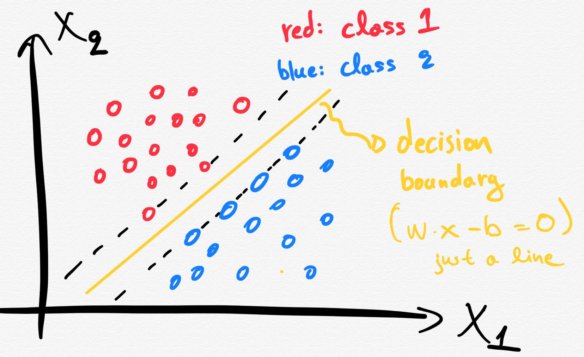
Support Vector Machines (SVM)
Support Vector Machines (SVM) clearly explained: A python tutorial for classification problems... | Towards Data Science

Slide 42
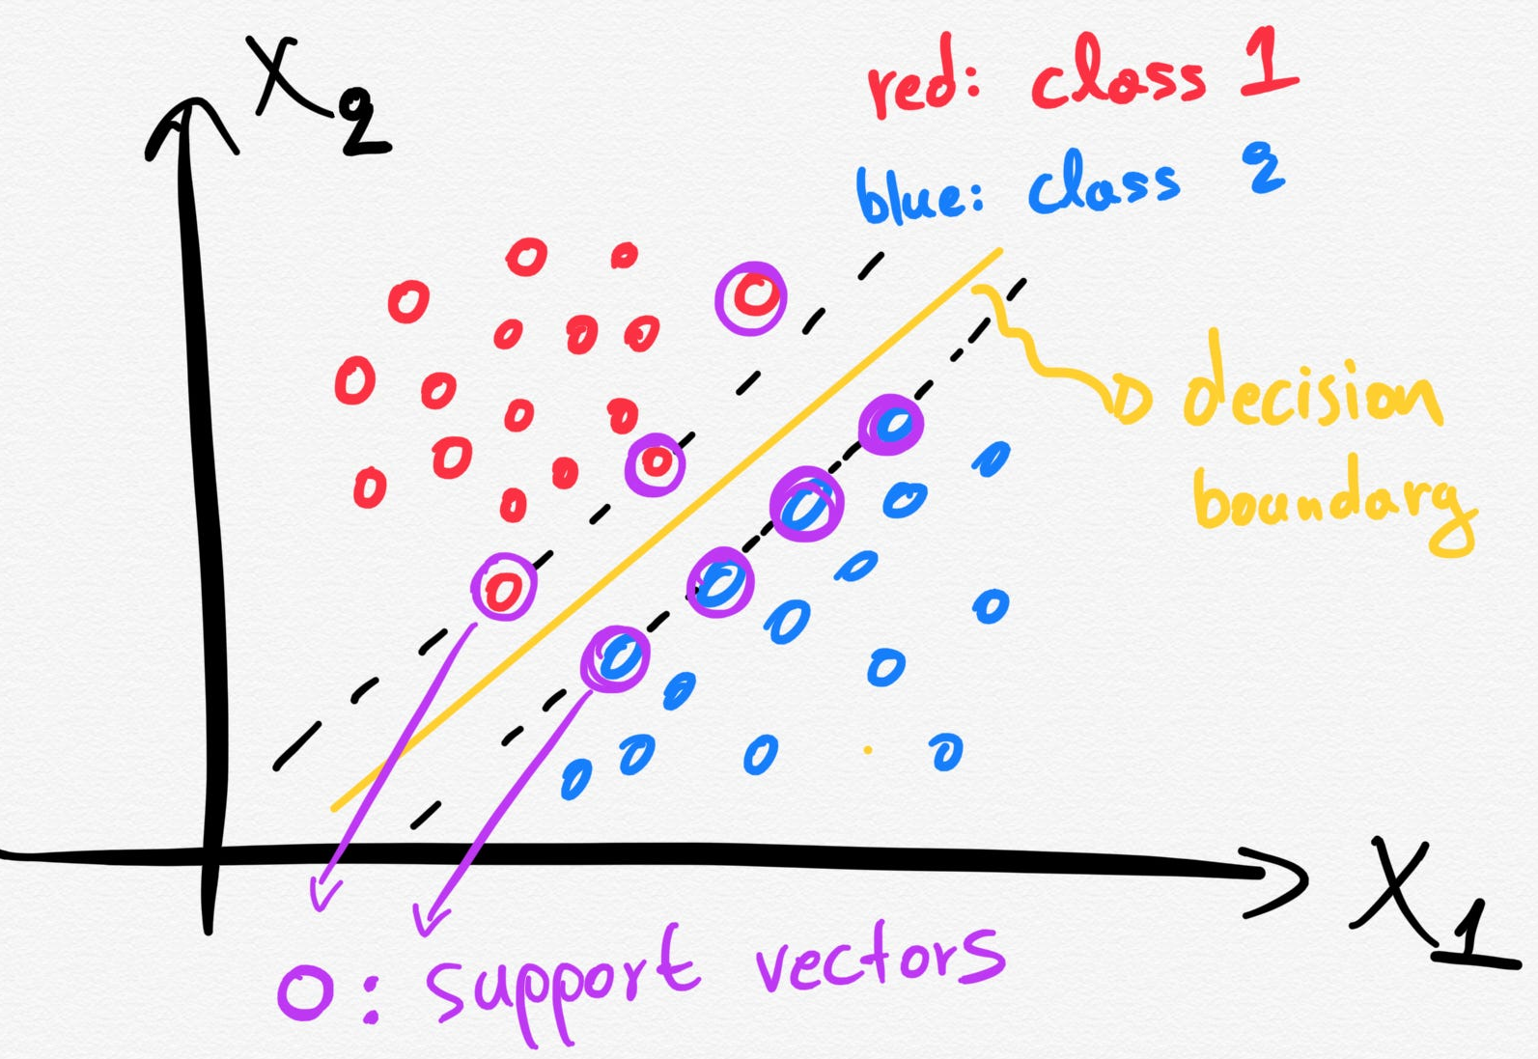
Support Vector Machines (SVM)

Slide 43
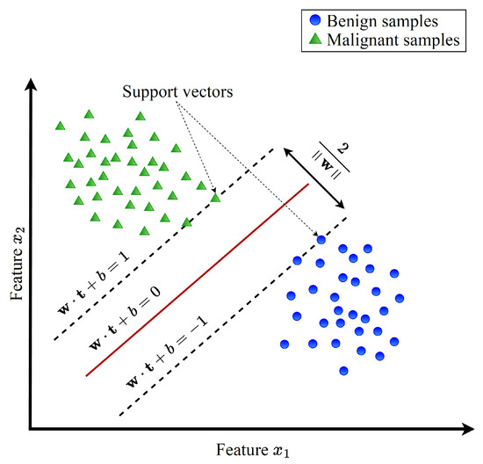
Support Vector Machines (SVM)
Lightweight Multi-Class Support Vector Machine-Based Medical Diagnosis System with Privacy Preservation

Slide 44
Unsupervised Learning

Slide 45
Unsupervised Learning
Unsupervised Learning is when a model learns from unlabeled data, no correct answers are given. The model tries to discover hidden patterns or groups on its own.
Example: Grouping customers into clusters based on their behavior (without knowing their categories before).
The model tries to identify patterns, groupings, or structures within the data on its own.
Unsupervised learning is often used for exploratory data analysis (EDA) and data segmentation.
Used for: Clustering (grouping similar data) and association (finding relationships in data).

Slide 46
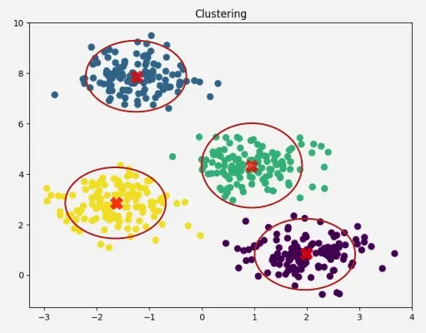
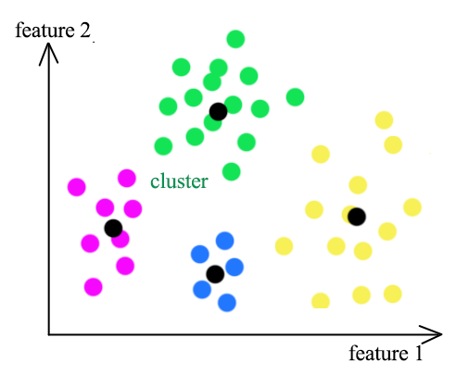
K-Means Clustering
K-Means is an unsupervised learning algorithm used to group unlabeled data into K distinct clusters based on similarity. Each cluster is represented by a centroid (mean point), and data points are assigned to the cluster with the nearest centroid.

Slide 47
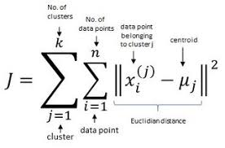
K-Means Clustering
How K-Means Works (Step-by-Step)
Choose K
Decide the number of clusters
Initialize Centroids
Randomly place K centroids in the data space
Assign Points to Clusters
Each data point is assigned to the nearest centroid
Update Centroids
Recalculate centroid as the mean of assigned points
Repeat
Steps 3 and 4 until centroids stop changing (convergence)
Mathematical Objective Function
K-Means minimizes within-cluster sum of squares (WCSS):
Distance Measure
Euclidean distance (most common)
Manhattan distance (less common)

Slide 48
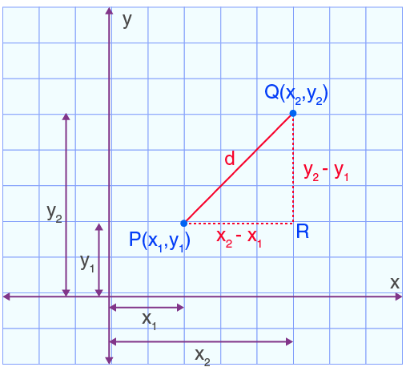
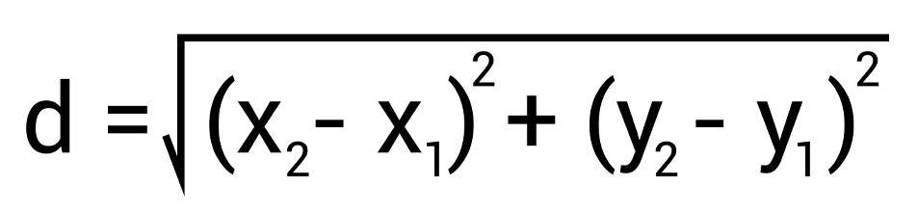
1. Euclidean Distance
It is one of the most commonly used measures to calculate the straight-line distance between two points
Formula
P(2, 3) :
x1=2, y1=3
Q(6, 8):
x2=6, y2=8

Slide 49
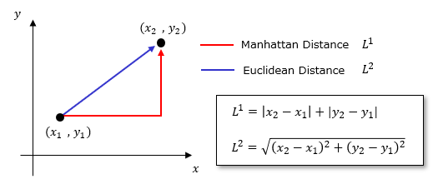
2. Manhattan Distance
It is also known as L1 norm or taxicab distance. It represents the path you would take if you could only move horizontally or vertically.
Formula

Slide 50
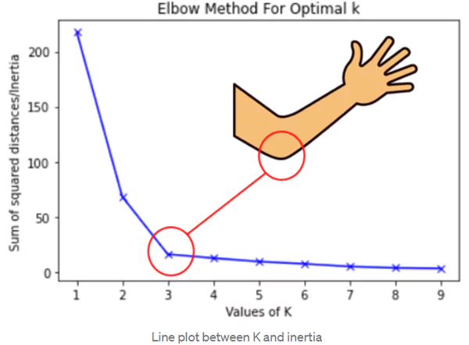
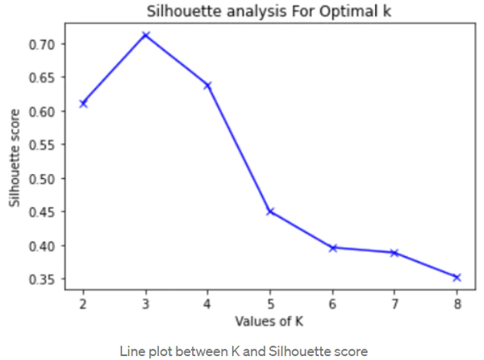
K-Means Clustering
Choosing the Value of K
Since K is user-defined:
Elbow Method
Plot K vs WCSS
Choose K where improvement slows
Silhouette Score
Measures cluster separation quality
K-Means: Getting the Optimal Number of Clusters- Analytics Vidhya

Slide 51
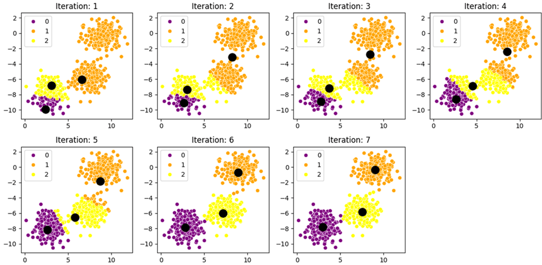
K-Means Clustering
K-Means vs K-Means++ Clustering Algorithm - GeeksforGeeks

Slide 52
K-Means Clustering
Advantages
Simple and easy to implement
Computationally efficient
Works well for large datasets
Scales easily
Limitations
Must choose K beforehand
Sensitive to initial centroids
Sensitive to outliers
Assumes spherical clusters
Performs poorly on non-convex shapes
Real-World Applications
Customer segmentation
Image compression
Document clustering
Network traffic analysis
Market basket analysis

Slide 53
Recap
Advanced ML Algorithms – I:
Supervised Learning
Decision Trees
Random Forests
Support Vector Machines (SVM)
Advanced Machine Learning Algorithms – II:
Unsupervised Learning
K-Means Clustering

